Slide 1
Matej Kriznar | B-IDDE skills development | October 2025
Docker
A Hands on Introduction
Charité Center for Global Health

Slide 2
Session Plan
Why use Docker?
Minimum working example
Package your R project in Docker
Simple pipeline with multiple Docker environments

Slide 3
Session Tools
Required: Computer with administrative rights
Desirable: Installed R
Useful: Unix based OS (Mac,Linux) and an R project you would like to package into a Docker container

Slide 4
Command Line

Slide 5
Command Line 1
Efficient use of Docker requires using command line
Terminal - a command-based environment where tasks are executed and displayed. It's interactive: you input commands, and the terminal shows outcomes.
Cloud server access and efficient tasks – especially in Unix based OS - rely on the terminal.

Slide 6
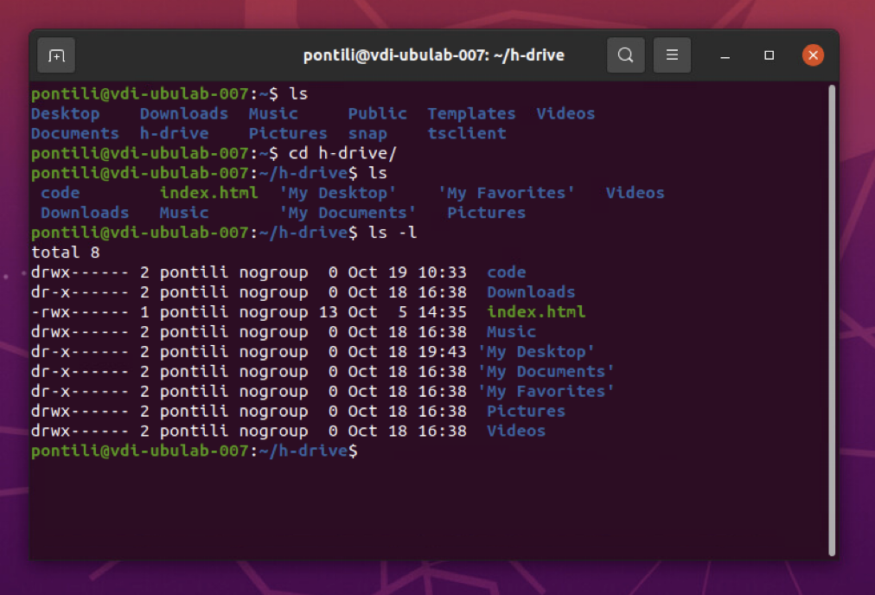
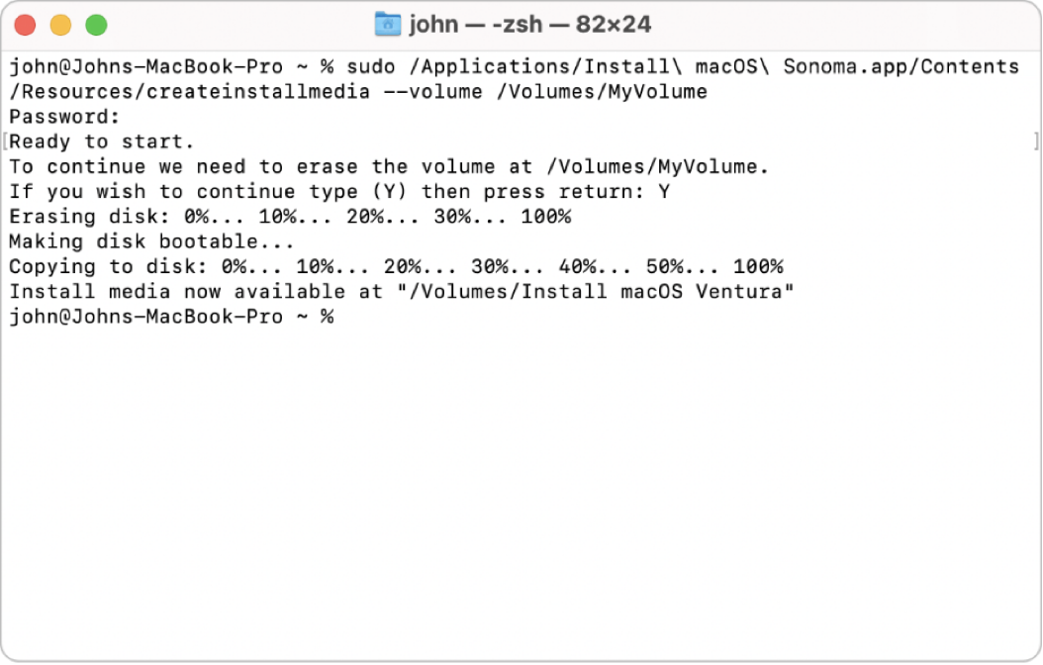
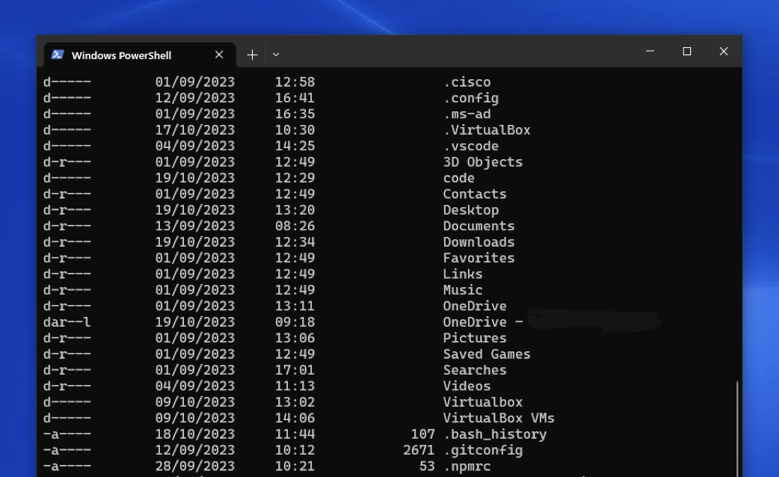
Command Line 2
Linux
Terminal Installed by default
MacOS
Terminal Installed by default
Windows
Powershell (pre-installed)
Windows Terminal (to be installed) Git Bash (to be installed)
Command Prompt (pre-installed)

Slide 7
Command Line 3
Cheat Sheet
Where am I?
pwd
What is in this folder?
ls
Move to Folder
cd Desktop
Create a file
touch filename.txt
Create a Folder mkdir foldername
Edit file nano filename.txt
Downloads
Root
User
Desktop
p1_r
…
We start here
We move here
Create this folder
cd Desktop
mkdir p1_r

Slide 8
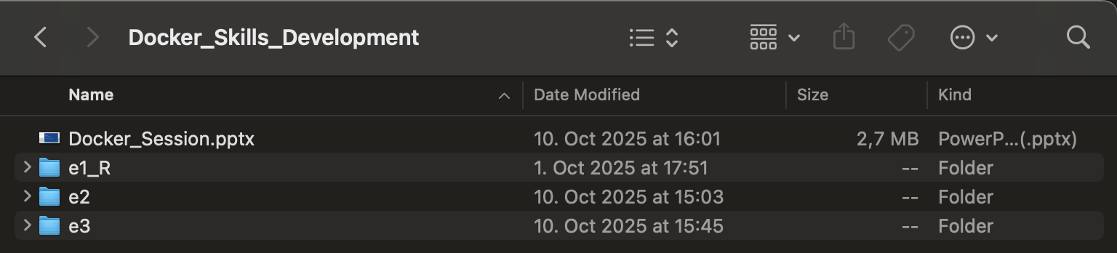
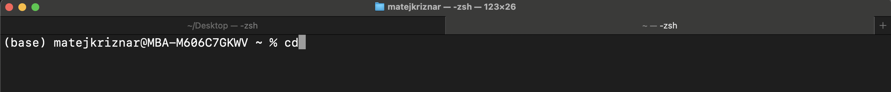
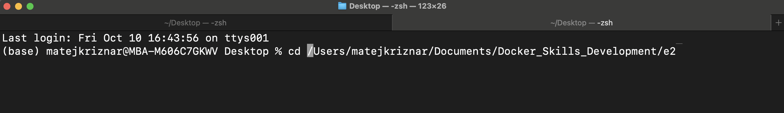
Command Line 4
Luckily drag and drop works as well

Slide 9
Why use Docker?

Slide 10
Reproducibility and Environment Sharing
Host OS
New host
R version, dependencies
Project
Online repositories
Data
Complex R environments, R versions, CRAN/Bioconductor packages
Reinstalling on a new computers potentially hours of setup and errors Complicates sharing with collaborators – difficult to guarantee same environment
Docker environment is captured once, runs anywhere

Slide 11
Software Incompatibility Nightmares
Tool 1 Only works on intel
No versions for Python 2.7+
Tool 2
No versions for Python <3.4
Data
Output
Different tools required different OS versions/dependencies
Creates conflict with your existing tools, other pipelines, even current hardwear
Installing a tool breaks two others, conflicting dependencies requiring deep dives into documentations
Pipelines fragile, difficult to reproduce or require cumbersome packaging (i.e. virtual machines)

Slide 12
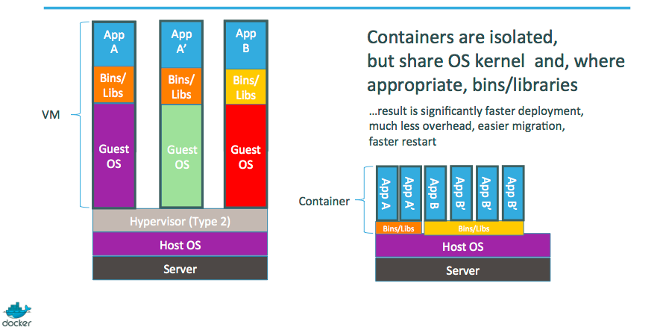
Containers
Isolate applications, offering Operating System (OS) functionality
Contains system tools, libraries etc. sharing only kernel with the OS
In some cases (new Apple silicon) the only virtualisation solution
Lightweight and portable

Slide 13
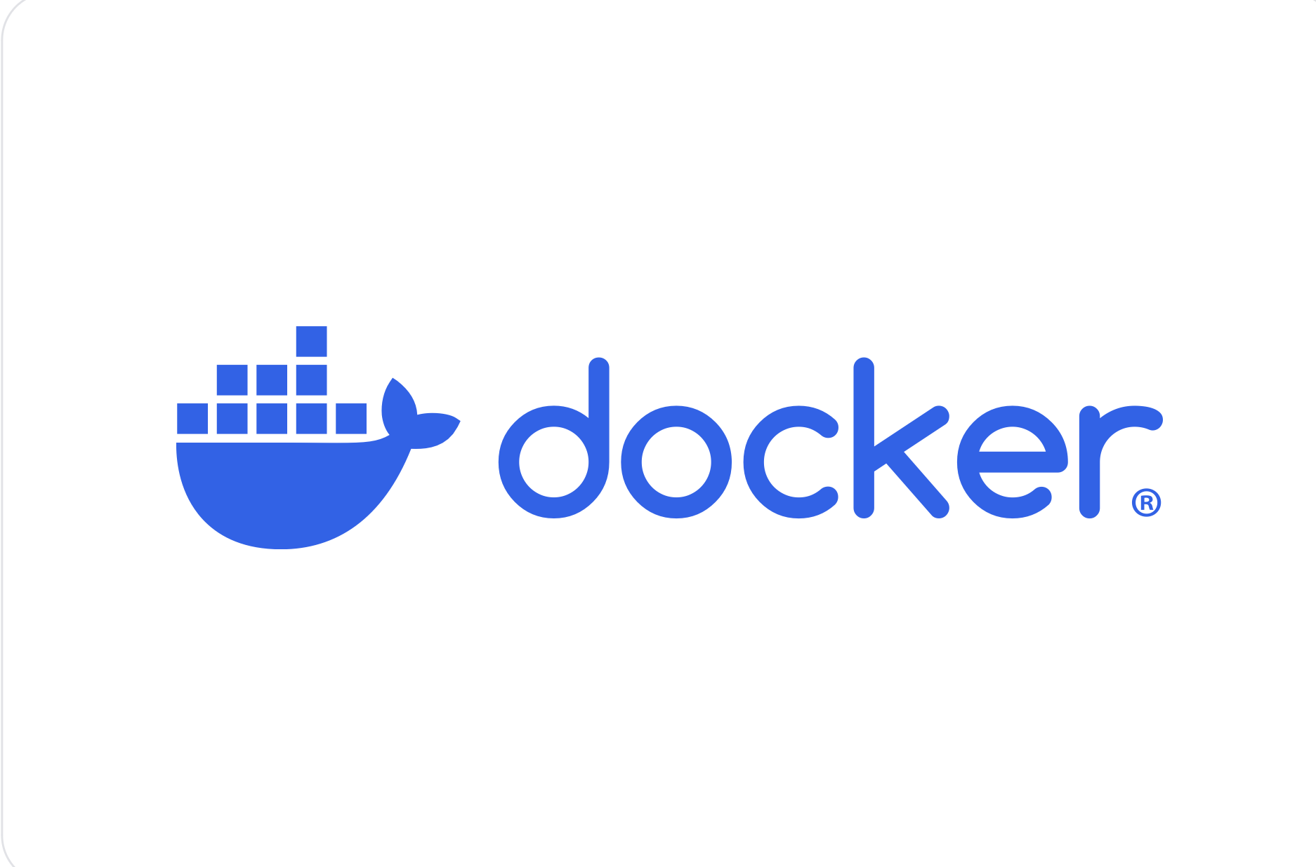
Docker
Most popular container engine
To create a Docker container we need a template (Docker image)
The template contains application and its configuration settings
There are many available Docker images – Python, R, SQL, Apache etc.
The recipe for a Docker container is a Dockerfile

Slide 14
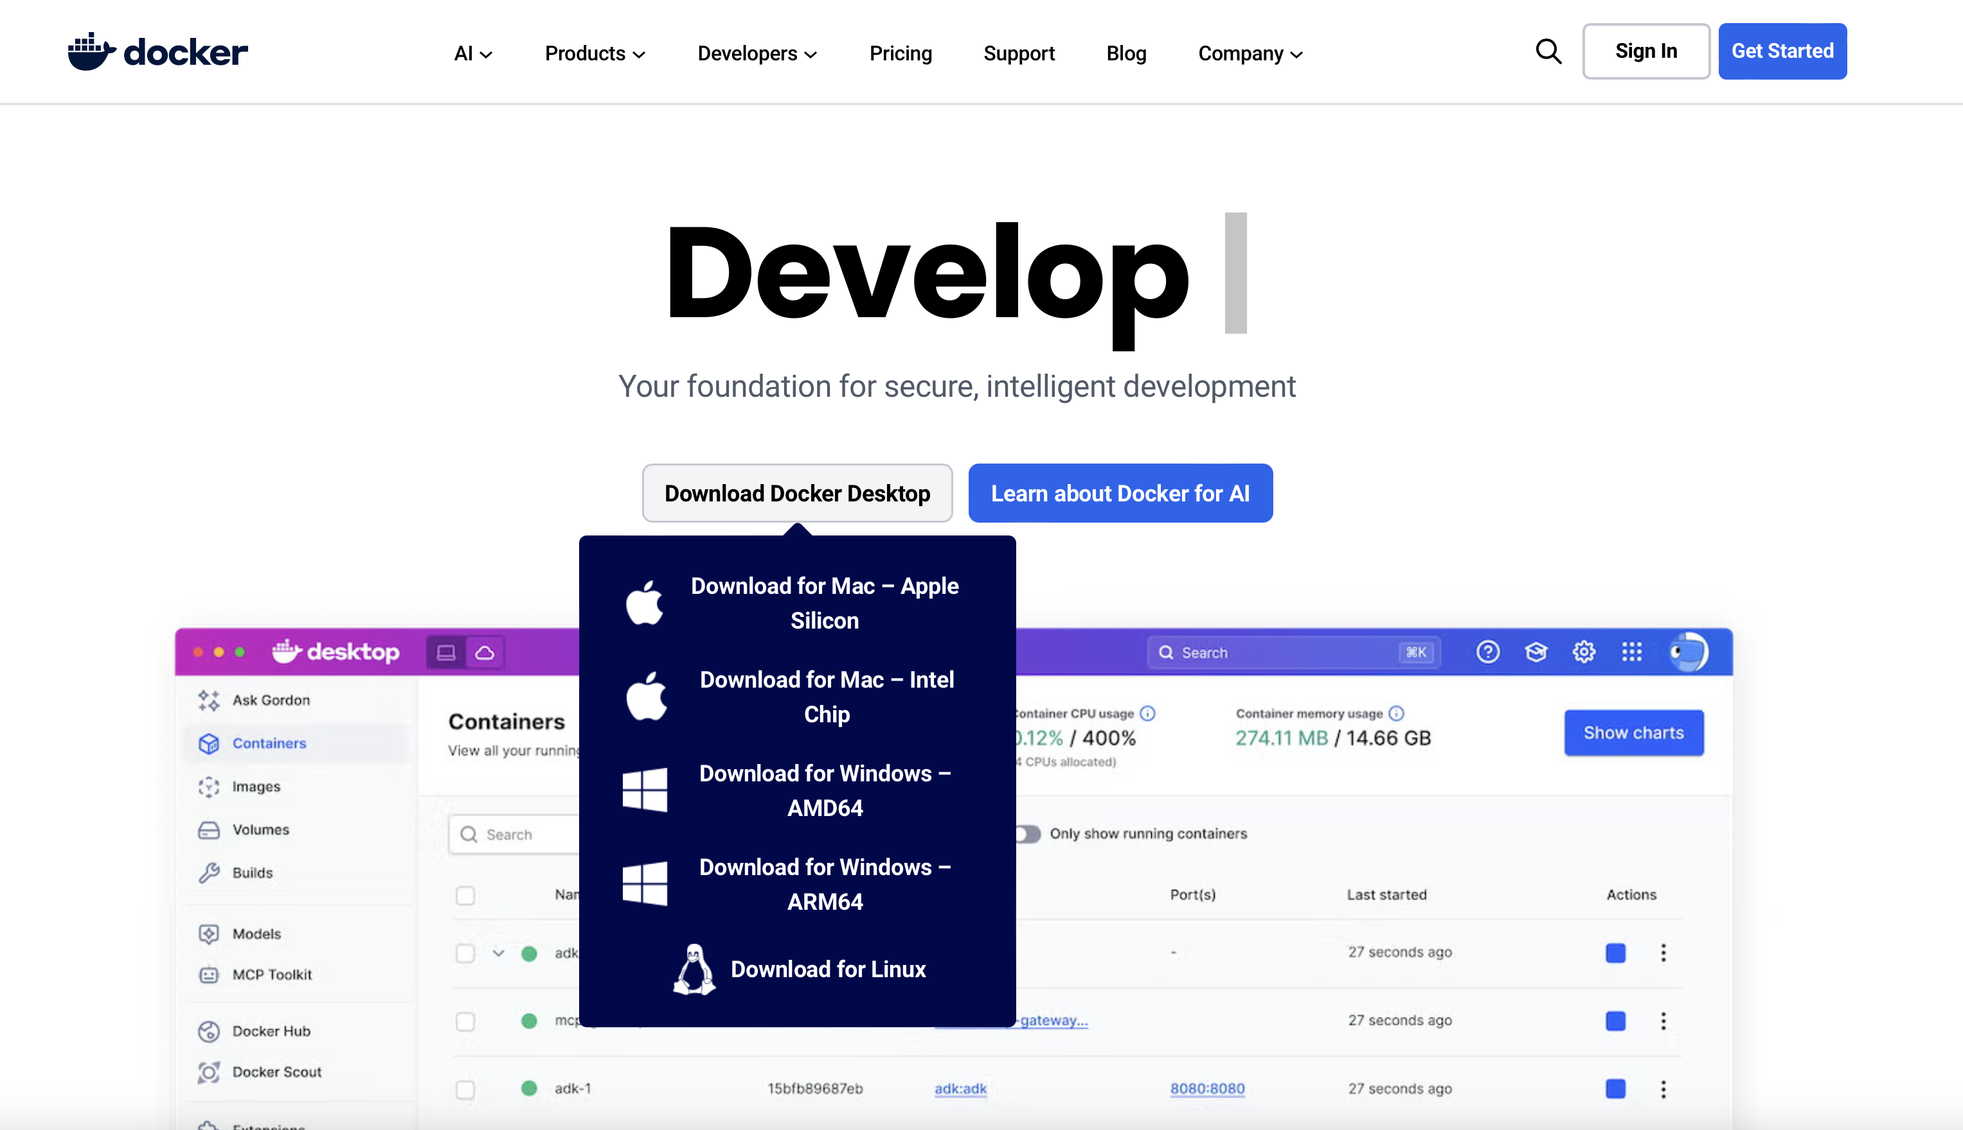
Installation
Test in terminal: docker run hello-world
Notes:
Tutorial for manually installing Docker in Linux here: https://docs.sevenbridges.com/docs/install-docker-on-linux

Slide 15
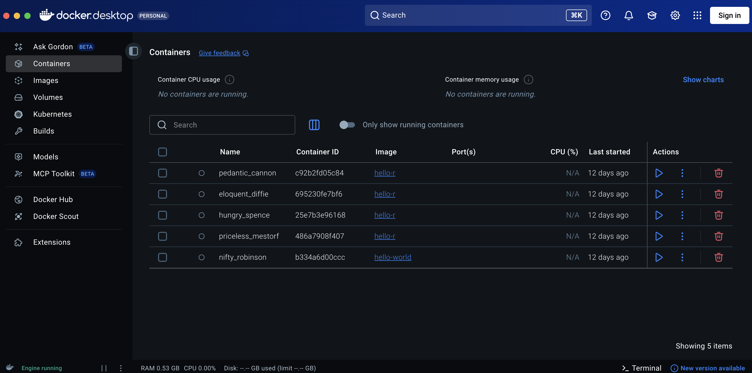
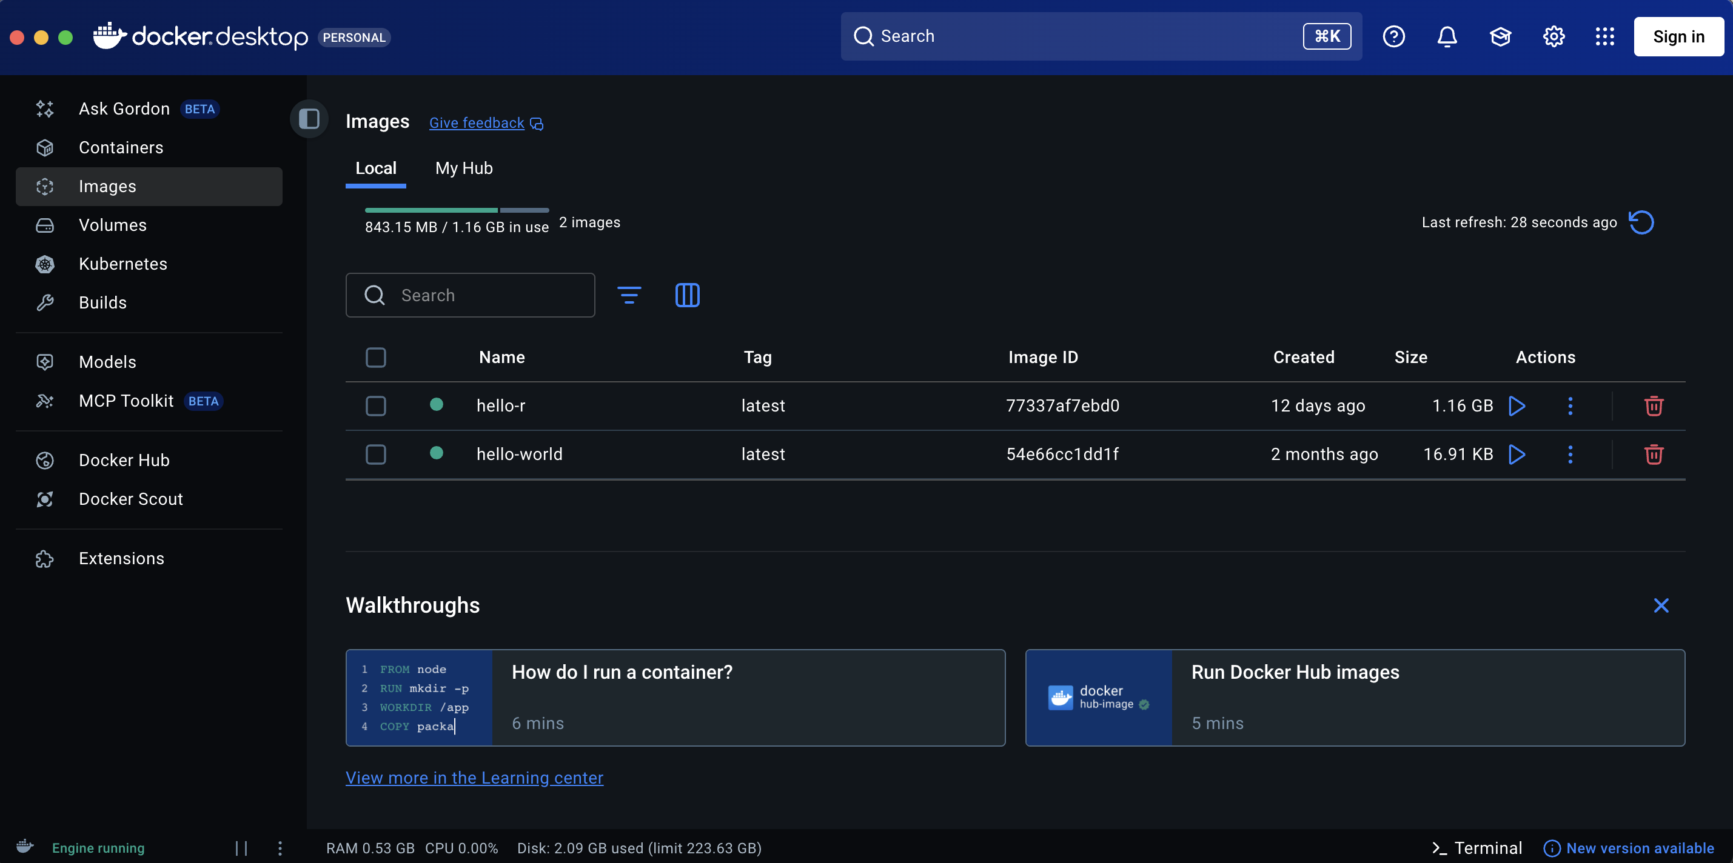
Docker Desktop
Containers tab will show created built containers
Images tab will show base images we have pulled

Slide 16
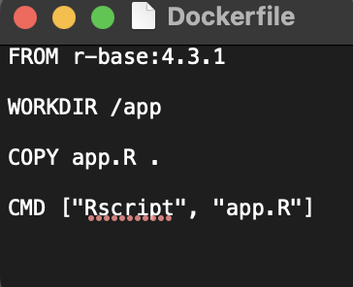
Anatomy of a Docker File
# 1. Base image: what environment to start from
FROM python:3.11-slim
# 2. Working directory inside the container
WORKDIR /app
# 3. Copy files from your computer into the container (data, executables)
COPY . .
# 4. Install dependencies
RUN pip install -r requirements.txt
# 5. Command to run when container starts
CMD ["python", "main.py"]

Slide 17
Exercise I

Slide 18
Exercise I. R
1. Move to Desktop
cd Desktop
2. Create exercise folder
mkdir E1_R
cd E1_R
3. Create docker file
touch Dockerfile
4. Create script
touch e1.R
5. Dockerfile:
FROM r-base:4.3.1
WORKDIR /e1
COPY e1.R .
CMD ["Rscript", ”e1.R"]
6. Script:
print("Hello Docker!")
7. Run in Terminal
docker build -t hello-r .
docker run hello-r

Slide 19
Exercise I. Python
1. Move to desktop
cd Desktop
2. Create folder
mkdir E1_Python
cd E1_Python
3. Create docker file
touch Dockerfile
4. Create script
touch e1.py
5. Dockerfile:
FROM python:3.11-slim
WORKDIR /e1
COPY e1.py .
CMD ["python", ”e1.py"]
6. Script:
print("Hello Docker!")
7. Run in Terminal
docker build -t hello-python .
docker run hello-python

Slide 20
Exercise II

Slide 21
Exercise II. Package Your Project
1. New Folder
Move to desktop
cd Desktop
Create folder
mkdir E2
cd E2
2. Project
Use either your own project
or
the one I emailed
Copy the project files into E2 folder

Slide 22
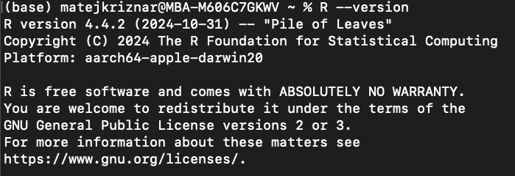
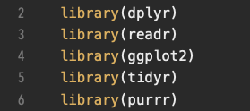
Exercise II. Understand Your Environment
Check R version
R --version
2. R dependencies
By default no centralised storage of dependencies
Manually parse dependencies from the script

Slide 23
Exercise II. Dockerfile
# Base image
FROM rocker/r-ver:4.3.1
# Set working directory
WORKDIR /project
# Copy all files into the image
COPY . /e_2
# Manually install R dependencies in the container
RUN R -q -e "install.packages(c('dplyr', 'readr', 'ggplot2', 'stringr', 'tidyr', 'purrr'), \
repos = 'https://cloud.r-project.org')"
# Default command to be run in this Docker environment
CMD ["Rscript", "scripts/main.R"]

Slide 24

Exercise II. Renv
-
Enables us to record packages (and versions) used
In combination with Docker allows for full recreation of an environement on a new host
Run in project folder (E2)
Rscript -e 'install.packages("renv", repos="https://cloud.r-project.org"); renv::init()'
Creates a storage of dependencies -> Lockfile

Slide 25
Exercise II. Dockerfile with Renv
# Base image
FROM rocker/r-ver:4.3.1
# Set working directory
WORKDIR /project
# Copy project files
COPY . /project
# Recreate R(env)ironment
RUN R -q -e "install.packages('renv', repos='https://cloud.r-project.org'); renv::init(bare = TRUE); install.packages(c('dplyr','readr','ggplot2','stringr','tidyr','purrr')); renv::snapshot()”
# Run script
CMD ["Rscript", "scripts/main.R"]

Slide 26
Exercise II. Testing Container
1. Build Docker Image
docker build -t e2 .
2. Run the script in Docker
docker run --rm -v "$PWD/output:/project/output" e2

Slide 27
Exercise III

Slide 28
Exercise III. Data
Copy Into Docker container
Small datasets, reference sequences etc.
Can either be done when building the container
COPY . /Data
Or directly into the running container
docker cp /path/on/host:/path/in/container
2. Mount into Docker container
General Approach
Flexible, without the need to move large files or rebuild containers
docker run -v /path/on/host:/path/in/container IMAGE_NAME

Slide 29
Exercise III. Pipelines
Data folder
Mounted to both containers
Container I
Container II
Output
Summarises data -> grouping by value and calculating means
Analyses summary -> Overall means
Outputs to data/final_out on host

Slide 30
Exercise III. Pipeline
Container I
FROM rocker/r-ver:4.3.1
WORKDIR /project
COPY process.R /project/
RUN R -q -e "install.packages(c('dplyr','readr'), repos='https://cloud.r-project.org')"
CMD ["Rscript", "process.R"]
Container II
FROM python:3.11-slim
WORKDIR /project
COPY process.py /project/
RUN pip install pandas
CMD ["python", "process.py"]
Bash Wrapper
#!/bin/bash
set -e
docker build -t r_stage ./r_stage
docker build -t py_stage ./py_stage
mkdir -p data/stage1_out data/final_out
docker run --rm -v "$PWD/data:/data" r_stage
docker run --rm -v "$PWD/data:/data" py_stage
cd e3 ./run_pipeline.sh

Slide 31
Next Steps

Slide 32
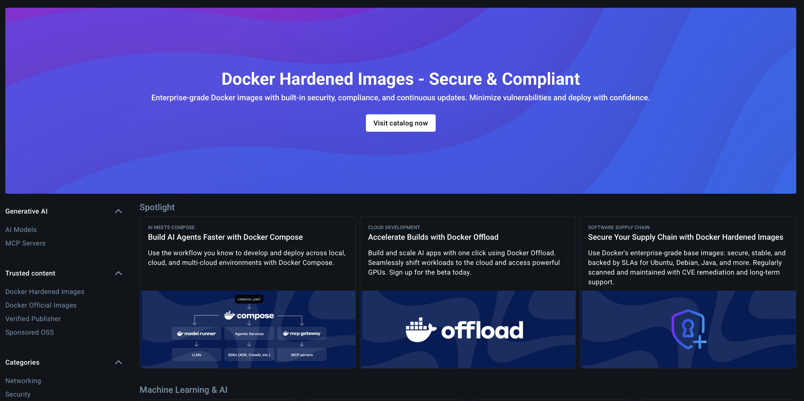
Next Steps 1: Docker Hub
Integral part of the Docker ecosystem
Private and public repositories of Docker containers
Allows for versioning in sync with Git (pushing an update on Git rebuilds the stored container on Docker Hub -> allows for storage and sharing of a fully replicable, self contained project/pipeline on your Git

Slide 33
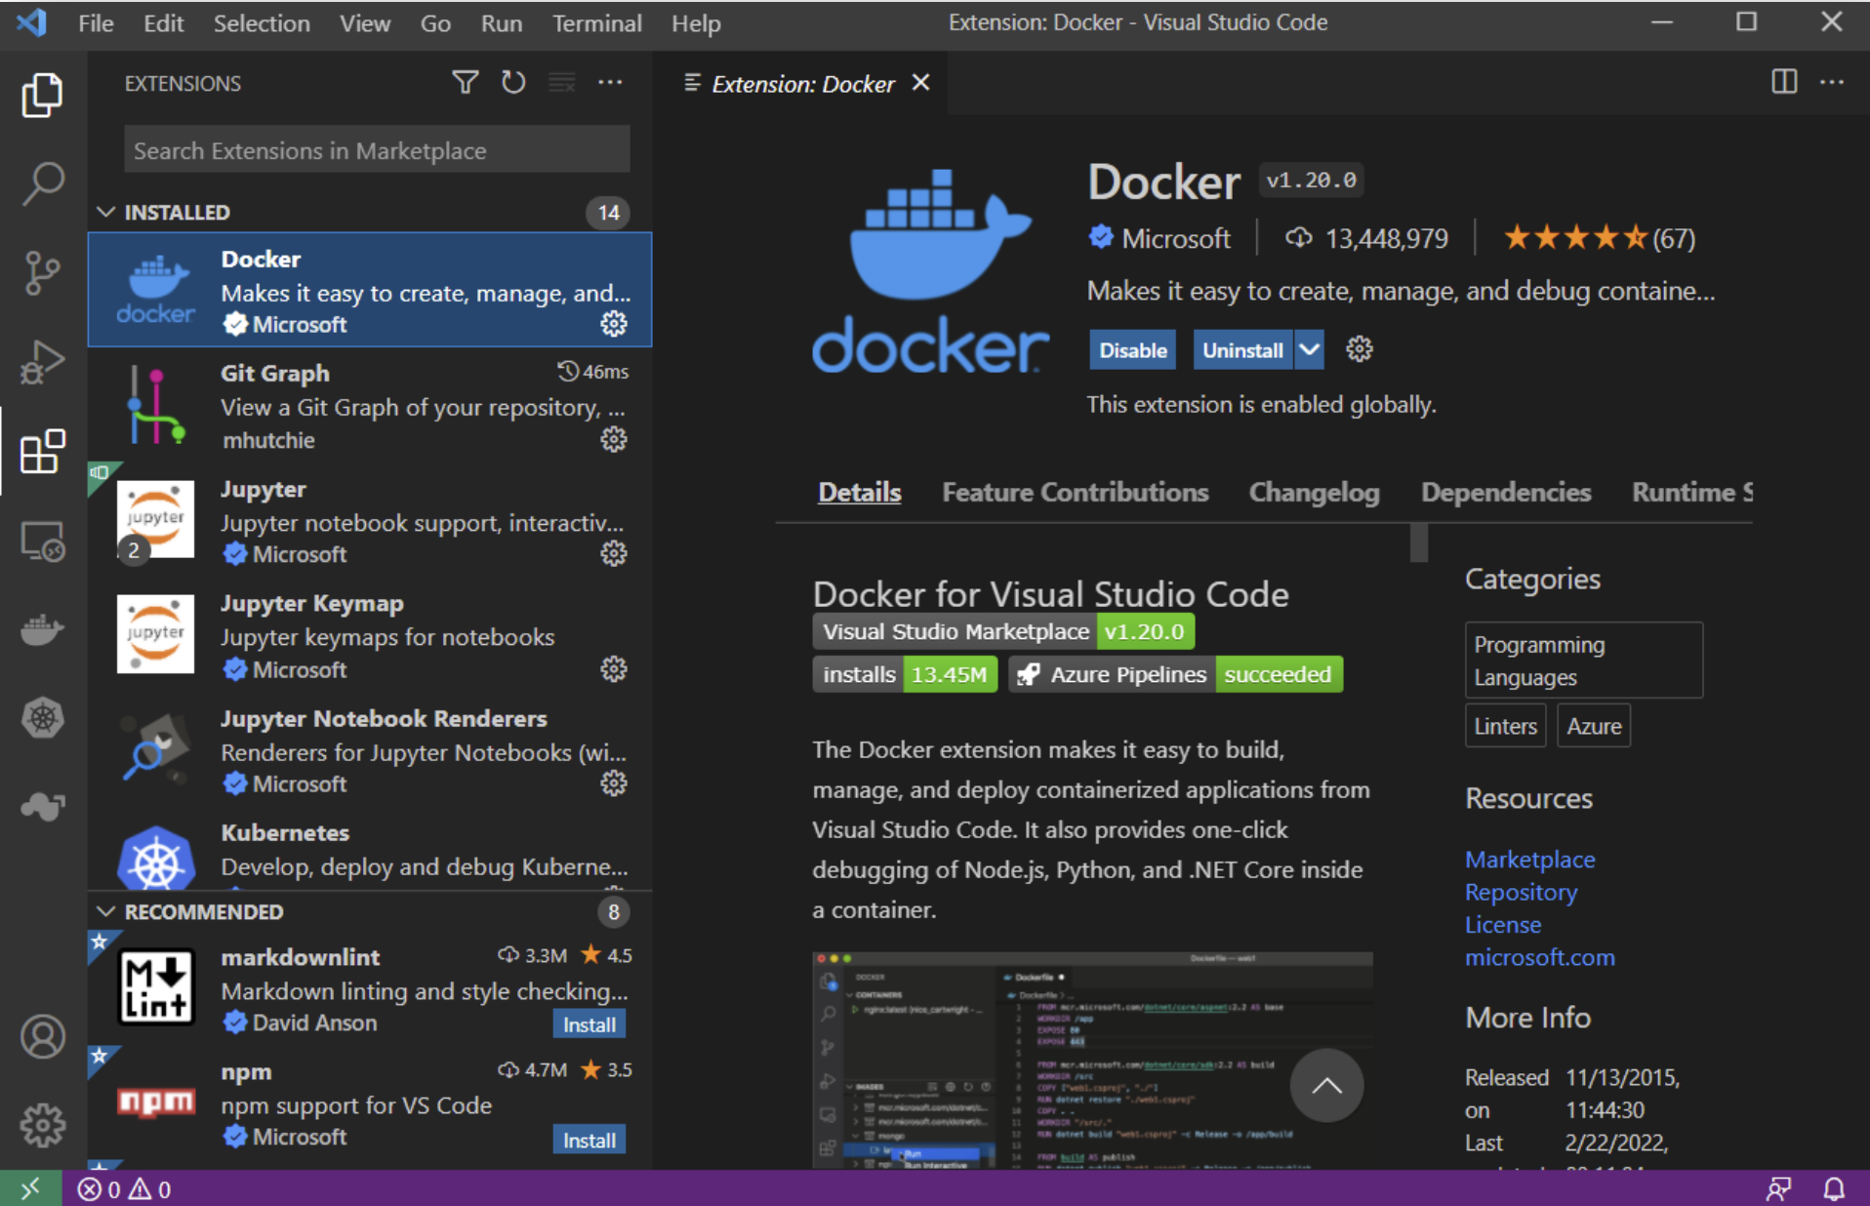
Next Steps 2: VScode Integration
VScode extension allows for full range of Docker operations from the IDE
With Dev Containers you mount your code into a persistent Docker environment while retaining full VScode editing and debugging capacity
Requires pre-installed Docker

Slide 34
Thank you all!

